Slide 1
Trailblazer

Slide 2
Food Tourism Platform
Food Tourism and Related Products E.g.: All in one place for Guided Tours, Wine Tours, Casual Food Tours, Formal Food Tours, Culinary Classes, Street Food Tours, Food Trucks.
Lacks a dominant player and is currently siloed.
Proposing a Simple but an Intelligent Platform.
Gain sentiments from feedback and improve loyalty.
Value added services. E.g.: Rearrange products on the fly, Recommendation Engine, Data Insights, Proactive Services, Integrate with CRM, Real time customer support, loyalty rewards.

Slide 3
Architecture
Social/Web
JS Framework
Server
REST API
Sentiment Analysis
JS Framework
API Callback
UI (Desktop, Tablet, Mobile)
Web socket
NoSql DB
Food Tourism Products
REST API
Value Added Service

Slide 4
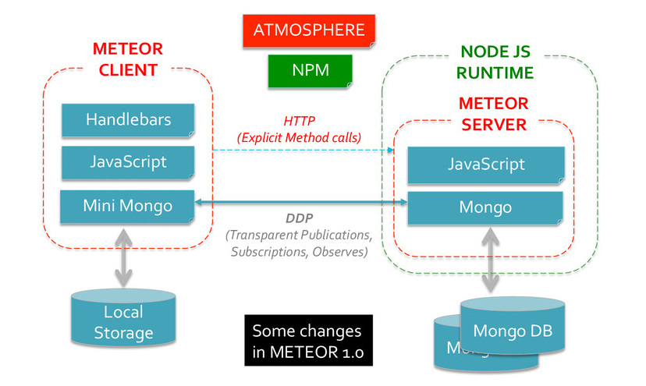
Full stack Java script FW
Fast and Easy Full Stack JS FW for Web App & Mobile App + Lightweight = Meteor JS or similar
https://www.mongodb.com/blog/post/meteor-build-ios-and-android-apps-are-delight-use

Slide 5
Sentiment Analysis
Feedback
Collect
Social
Sentiment Analysis
Over time
Geographic area
Customer
Recommendation
Improve Product
Proactive Service
Marketing
Offers
Loyalty
Rearrange campaign
Sentiment Analysis
Improve
2. Targeted Offers
3. Integrate CRM
4. Attract
5. Incentives
6. Loyalty
API, Database, Crawl, Scrape
Documents
Process
Data
NLP, Extract Sentiment

Slide 6
Value Added Service
Real time data insights.
Real time customer support for the duration of service.
Recommendation Engine.
Rearrange products on the fly based on feedback or sentiments.
Loyalty for using the platform, products, referrals and providing feedback.

Slide 7
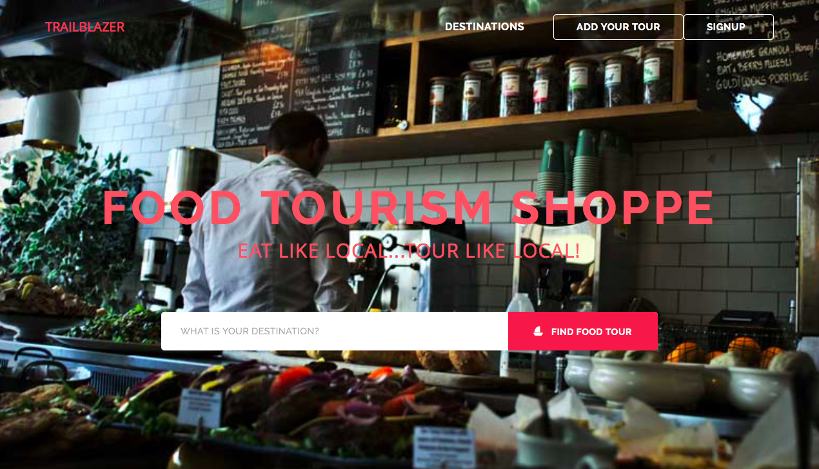

Slide 8
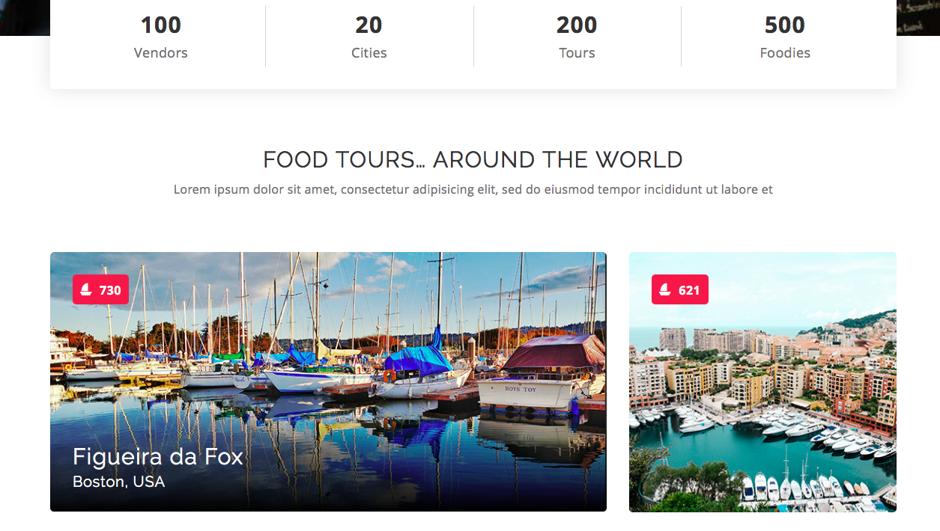

Slide 9
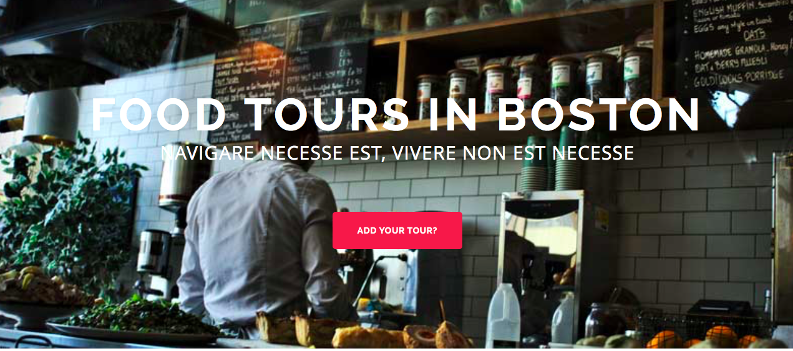

Slide 10
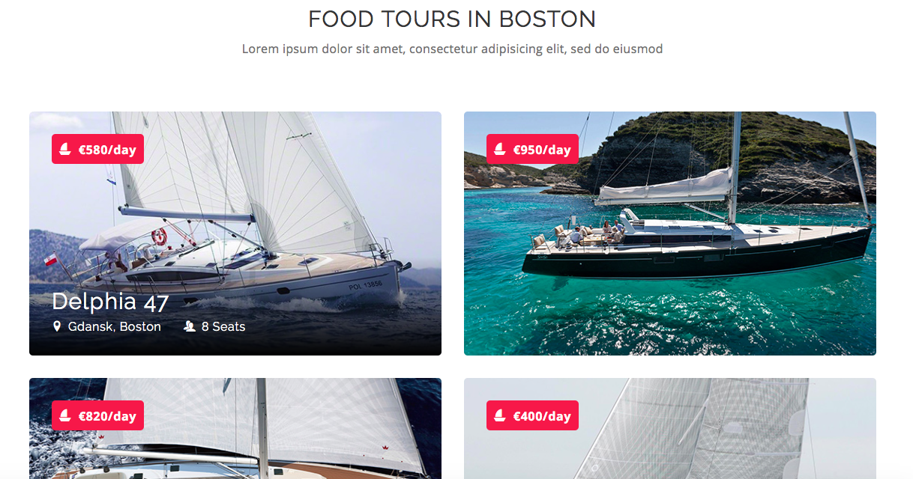

Slide 11
Milestones
Sort out requirements – 1 month
Complete a prototype – 3 months
- Sign up
- Add your products – basic form
- View all products on the main page
- Provide feedback via comments on each products
- Sentiment analysis of the product
Get suggestions on the proto – 1 month
Minimum Viable Product – 3 months
Value Added Features

Slide 12
Rohit Slides

Slide 13
GASTRONOMY – The Idea
Idea is to create a location aware platform that caters to the rising trend of Food tourism and provides feedback to the relevant stakeholders.
According to market research, 88% of the destinations consider gastronomy strategic in defining their brand image.
Around $12 billion dollars spent in last few years on culinary activities while travelling
Around 27 million culinary American leisure travelers in last 3-4 years.
The platform will target global as well as local customers and provide them notifications/suggestions based on historic data about their food preferences.
It will serve as an advertising platform for local restaurants, bars, street food vendors etc. that notifies their target customer base about specials, new menu additions etc.

Slide 14
Product Differentiation
Companies such as Yelp, Zagat are pure rating based businesses. Even though they capture static user feedback, there is dearth of real sentimental analysis, feedback mechanism and engagement.
No platform today that caters to local and global rise of culinary tourism.
Today’s food and beverage industry is highly competitive and lacks a platform that enables new product offerings/business opportunities with feedback mechanism.
No current platform that tracks guest FoodDNA and suggests unique culinary experiences based on Gastronomical Data.
Lack of a platform that captures local food culture and local sentiment to offer unique travelling experiences to global visitors.

Slide 15
Platform Concept
Users/Guests
Guest signs up
Guest details such as Cuisine preference, Age, Ethnicity etc. are captured.
Platform tracks various food-joints/restaurants/bar visited, captures Guest feedback and builds guest FoodDNA i.e. user “Gastronomical Data” that reflects culinary history.
Guest accumulates loyalty points which can then be redeemable towards any offering/restaurant in the network.
Guest is notified about upcoming local food tours, special offerings from restaurants in local geographic area, etc.
Incentives for inviting/recommending friends and family to join the network and share experiences.
Guest visits a new location, the platform suggests the guest about the local food joints based on culinary preference, local sentiments, previous visited places i.e. Guest FoodDNA
Guest is able to view ratings/review of other guests and get a sense of average sentiment

Slide 16
Platform Concept
Platform Products
Local Restaurant Network
Loyalty Awards
Food Tours (Local/Global)
Special Services (Culinary Classes, Local Gastronomy Tours etc.)
Insights into user sentiments about offerings.
Instant advertising platform for businesses attracting local area customers.
Special Occasion offerings (e.g. Birthday, Anniversary etc).
Interface to OpenTable for reservations
Interface to Facebook, Twitter for sharing experiences.
Database of guests FoodDNA and local geographic Gastronomical Data

Slide 17
Platform Concept
Businesses (e.g. Restaurants, Bars, Food Trucks etc.)
Sign up
Ability to categorize its offering (cuisine, atmosphere, culture etc.)
List new products (e.g. menu additions)
Ability to instantly advertise specials, offers etc. to local area consumers.
New revenue generation opportunities such as Culinary Classes to frequent members
Collaboration with other local restaurants for combined culinary tour.
Offer value added services like instant customer service to the guests.
Ability to gauge consumer sentiment about the offerings.
Ability to view Gastronomical Data for new business opportunities.

Slide 18
Sentimental Analysis
What is Sentimental Analysis ?
Ability to extract positive or negative feelings from a constant stream of incoming messages using Natural Language Processing (NLP).
Helps in measuring overall value of the product/brand.
Also known as Opinion mining.
Why is it Important ?
In today’s competitive world, customer experience is a huge differentiator
89% of the companies expect to compete on customer experience in the future
In the present world of cut throat competition, only exceptional products/services will stand out.
With sentimental analysis, businesses can turn data into actionable insights.
Helps to connect with the customers on an emotional level.

Slide 19
Sentimental Analysis - Benefits
Mine Feelings, not just Facts
Capture and Quantify Sentiments at Large
Enhancing Customer Service
Gaining Competitive Advantage
Gaining Business Intelligence
Revitalizing the brand
Increases customer engagement

